Slide 1

Team Guatemala
University of Notre Dame BUSINESS ON THE FRONTLINES

Slide 2
Problem Statement
How might CRS & their partners use amaranth among poor farming families to:
Improve early childhood nutrition
Increase farming family income by connecting to markets to sell surplus crops

Slide 3
outline
Amaranth project is viable
Nutrition benefit (data)
Market is attractive
Association
People will eat it (behavior change)
Aggregators connect to markets
Significant value add to farmers for processing

Slide 4
Amaranth Nutrition Benefit
Slide 14 (Jess reformatting)
Kerri’s graphs

Slide 5
Amaranth Market is Attractive
Demand exceeds supply
Profit potential ~3x > corn

Slide 6
People Will Eat Amaranth
Behavior change

Slide 7
“Aggregators” Connect to Markets
Associations as strongest model we researched…

Slide 8
Value Add from Associations
Value add can be passed to farmers if the can do more post-processing

Slide 9
Problem Statement
How might CRS & their partners use amaranth among poor farming families to:
Improve early childhood nutrition
Increase income by connecting farmers to markets to sell surplus crops

Slide 10
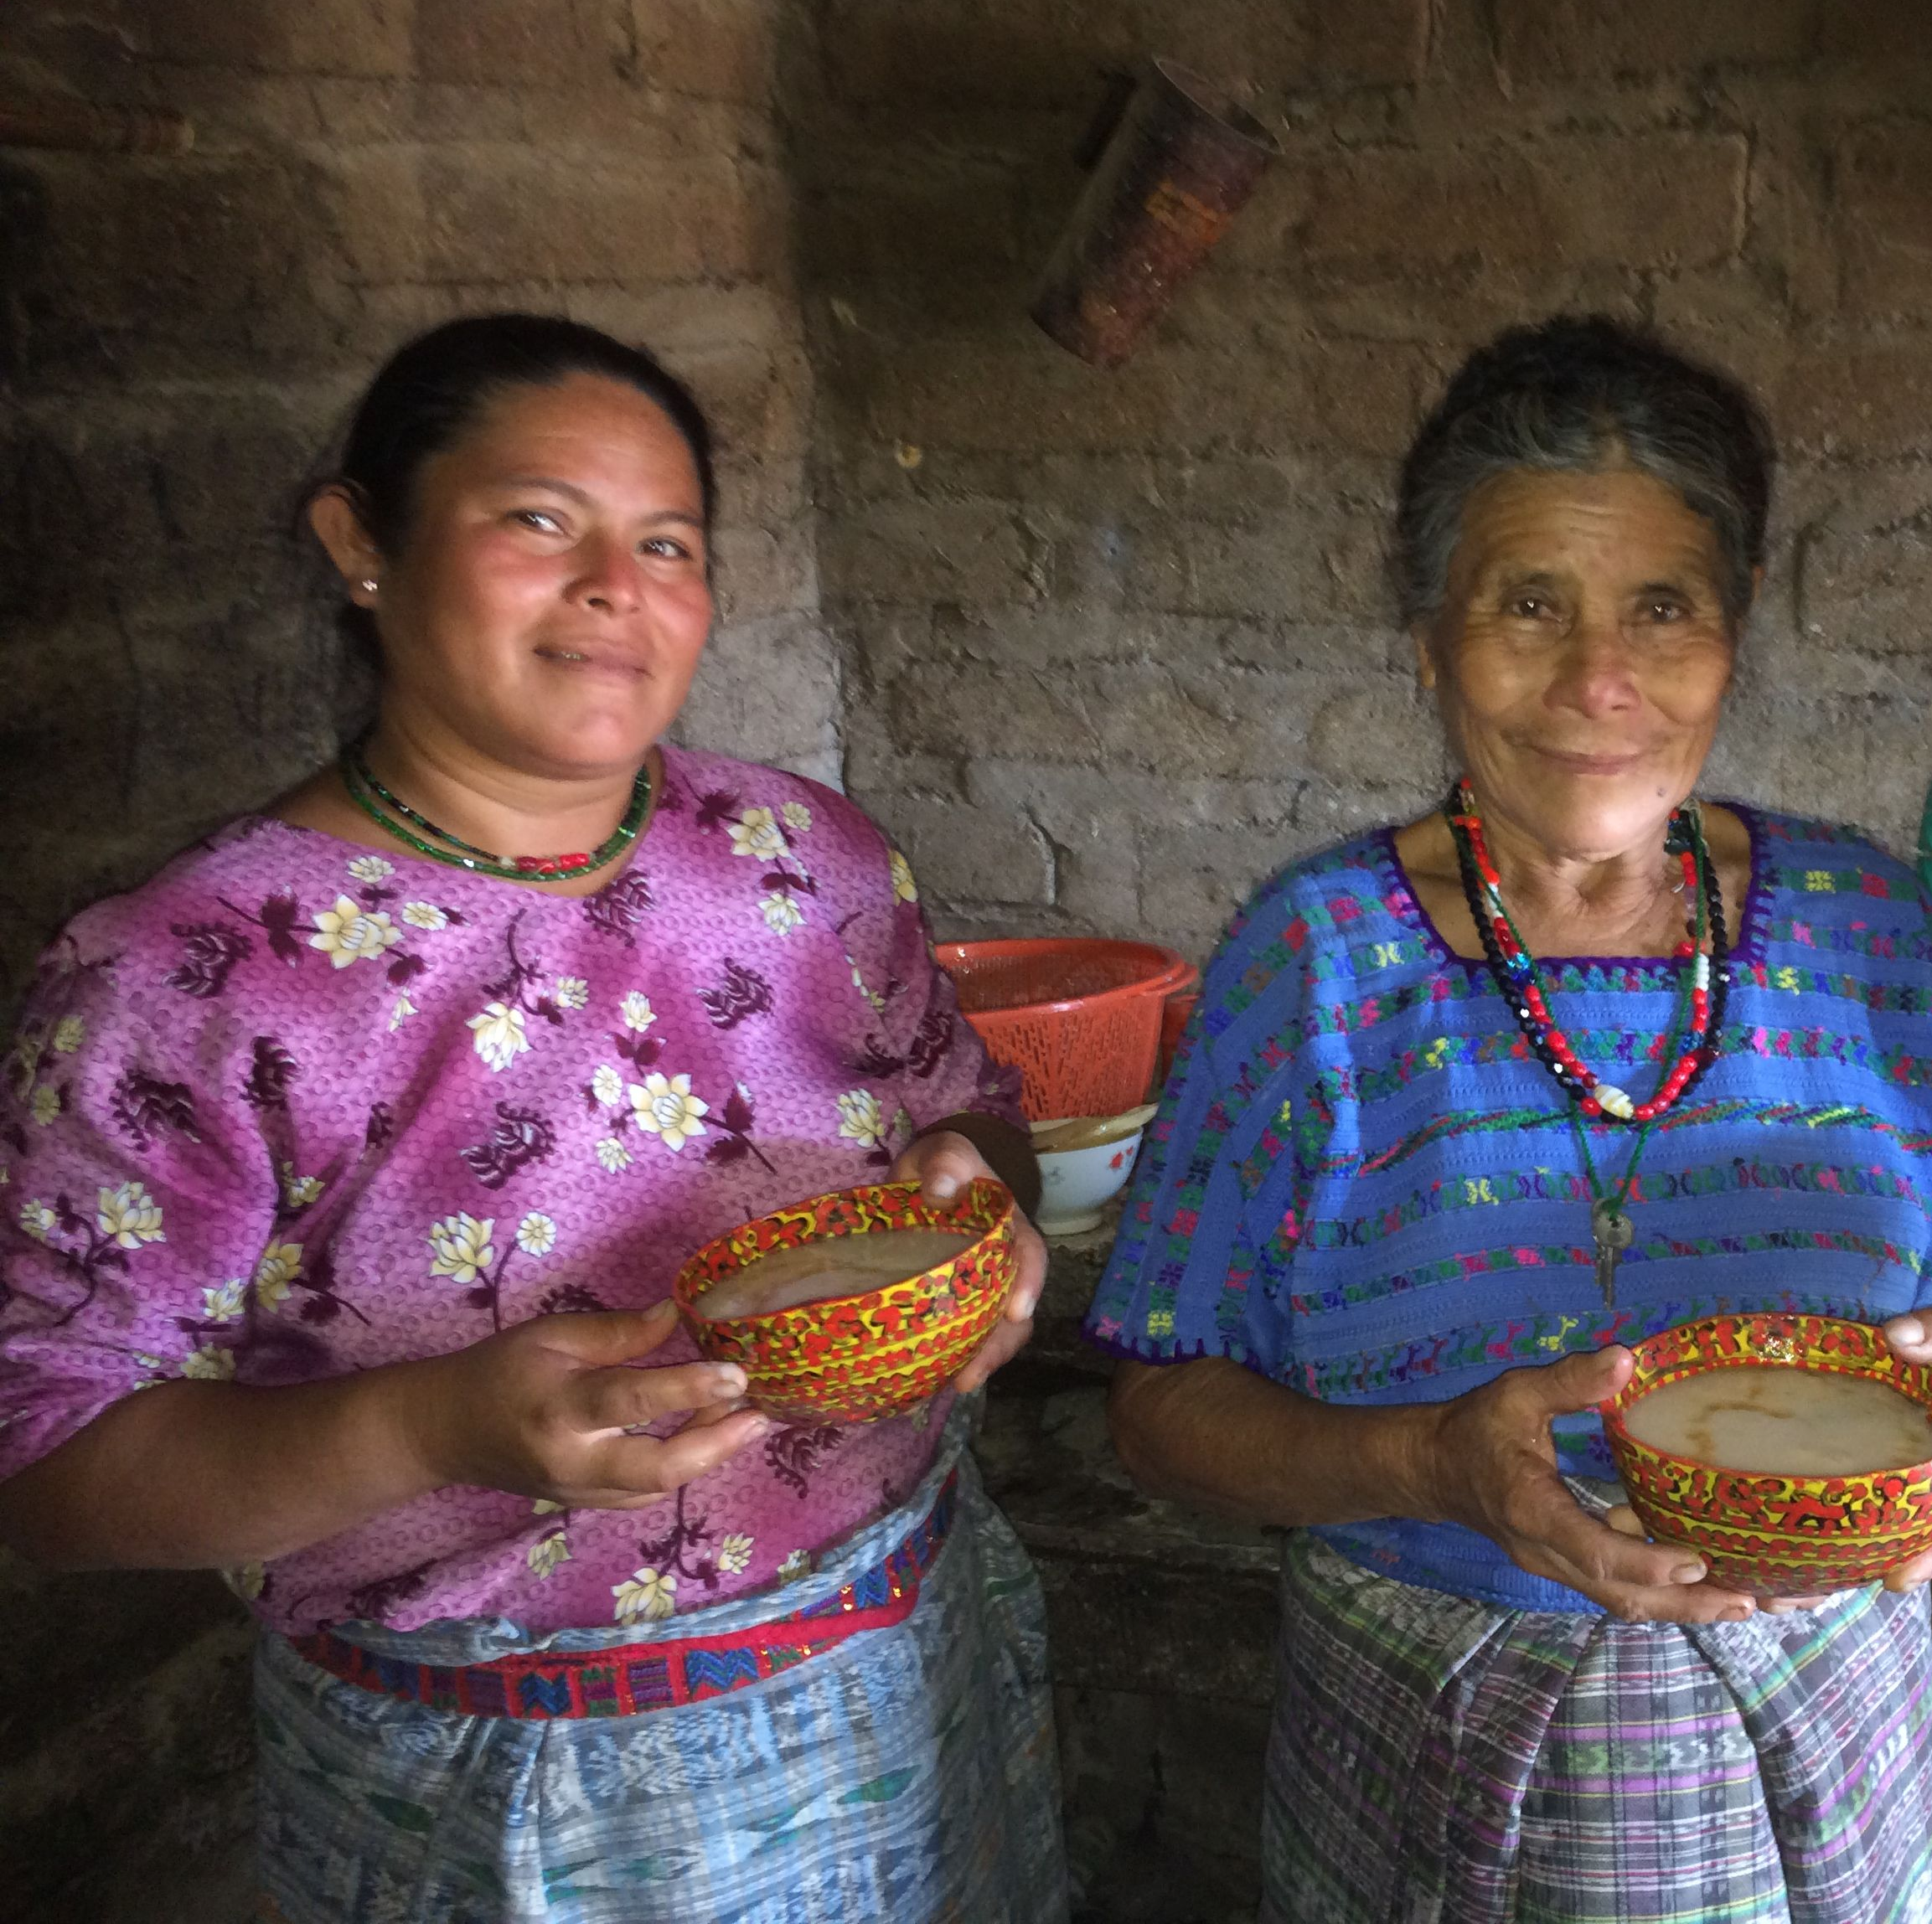
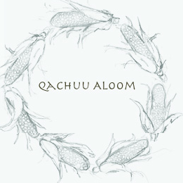

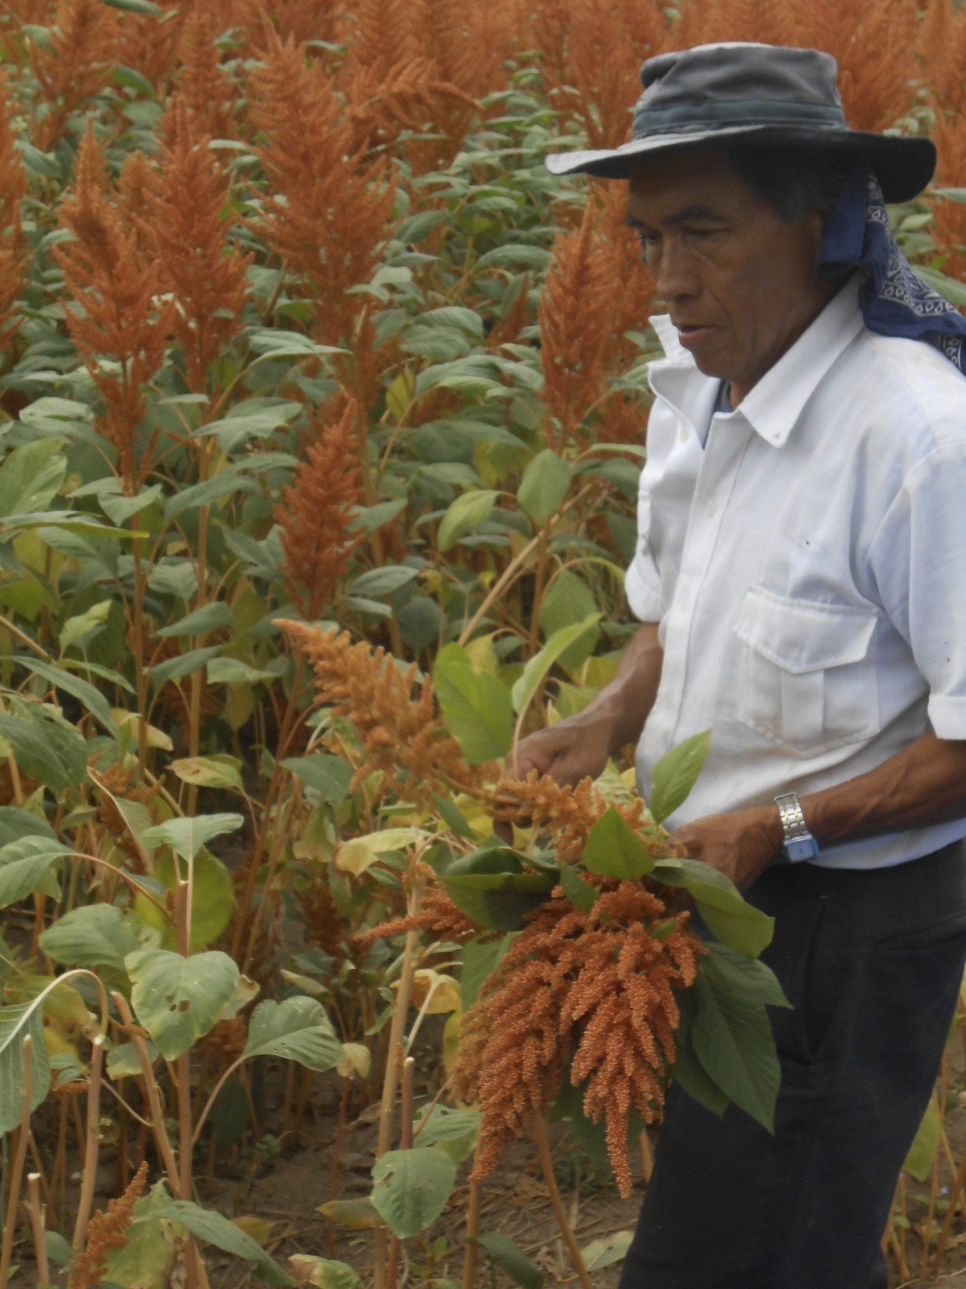
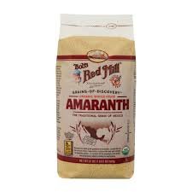
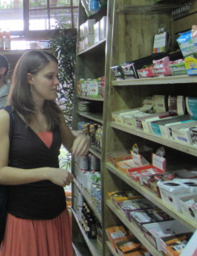
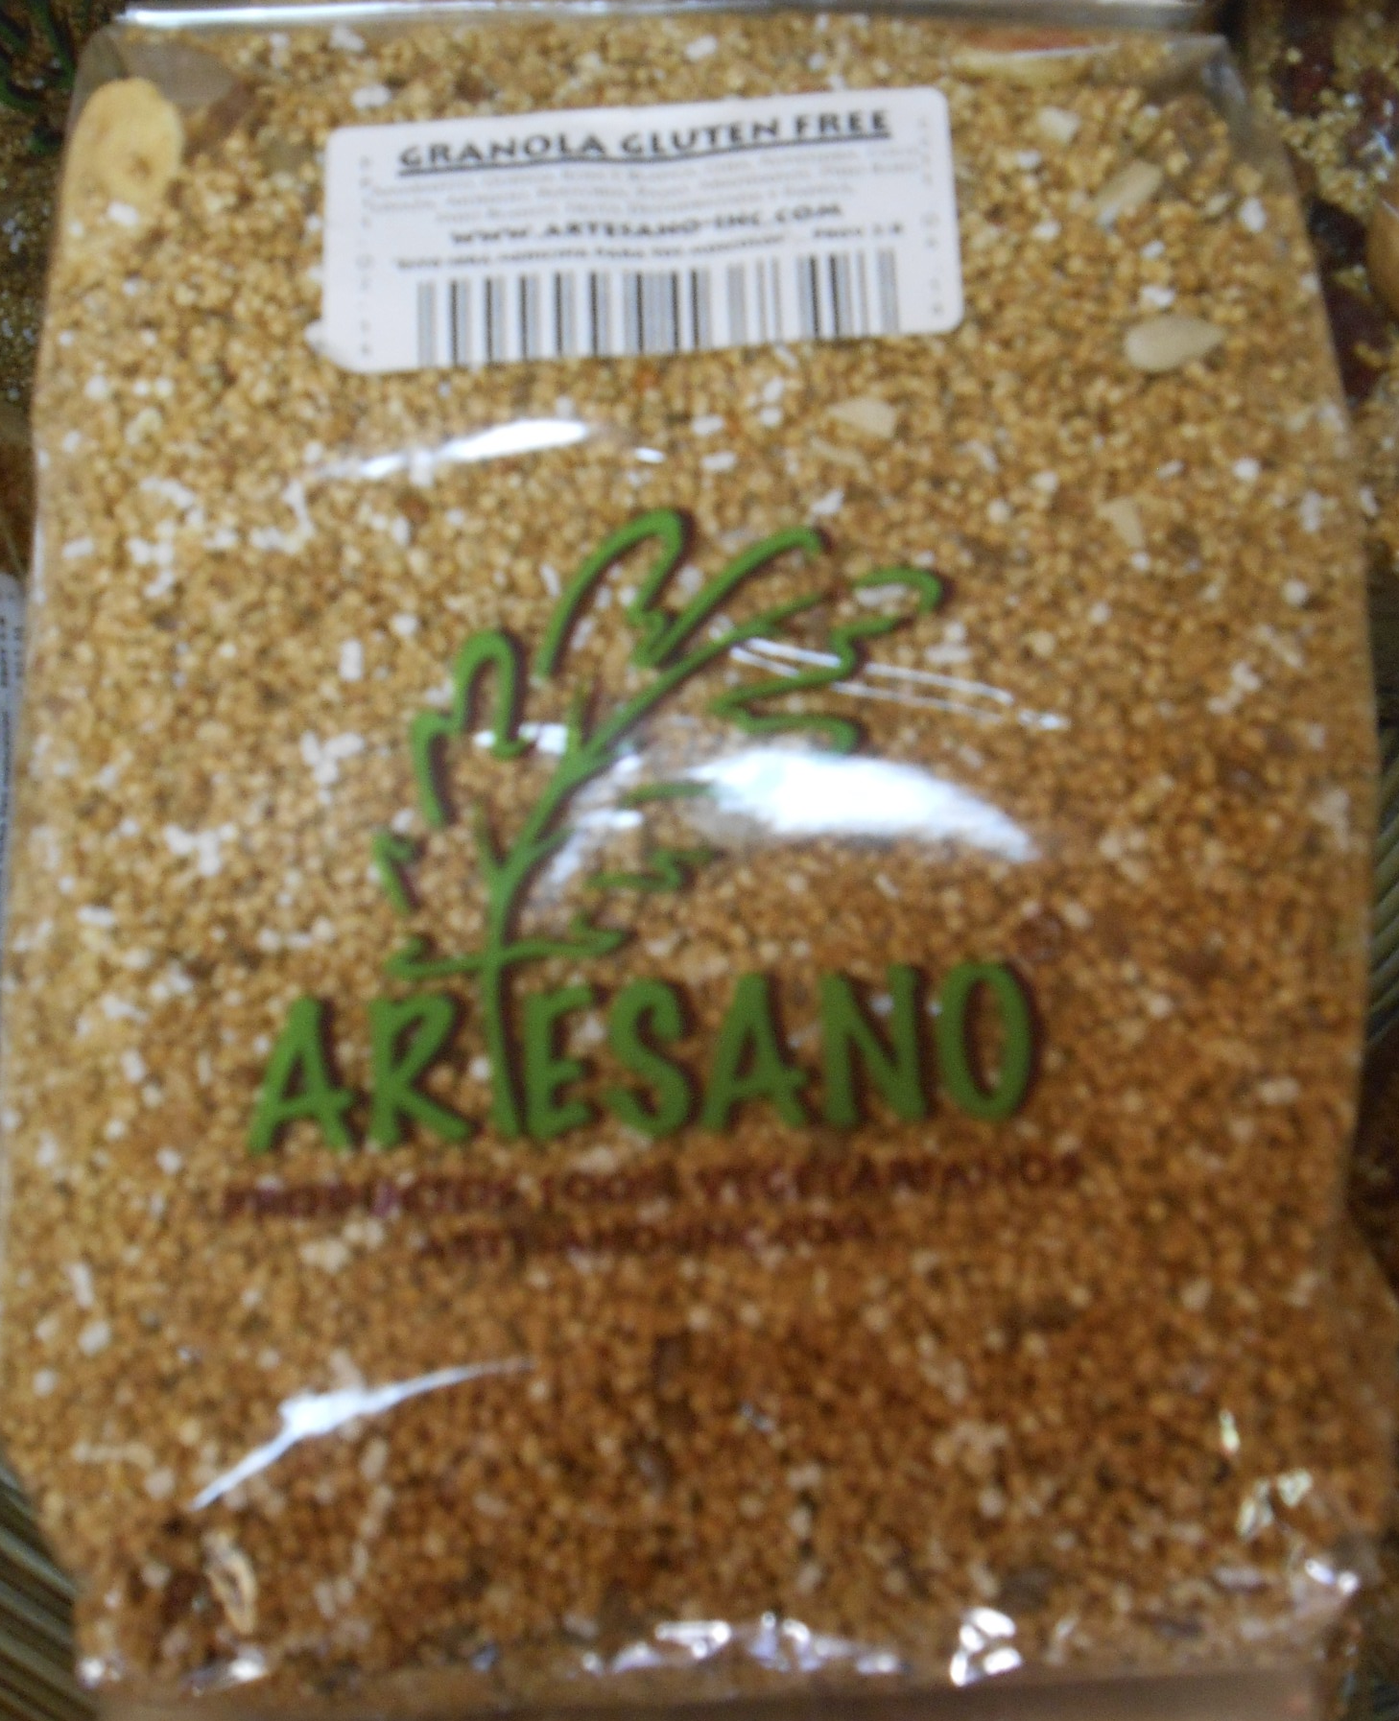

Our Approach:
GOALS: Understand Our Beneficiaries &
Trace the Guatemalan amaranth value chain
Families / Individual Consumption
Small Scale Farmers
Associations (Organizers)
Bulk Buyers (Local or Export)
Customers

Slide 11
Findings & Recommendations
Conclusion #1
Amaranth is a viable intervention for addressing malnutrition and improving livelihoods
Conclusion #2
The critical factors are seed selection, technical training, dietary change and strong organizational structure.
Conclusion #3
The critical gap in the value chain is at the association/organizer level.
Conclusion #4
Significant value creation and capture can happen at the association/organizer level.

Slide 12
Findings & Recommendations
Supporting amaranth cultivation in rural communities is a viable strategy to address malnutrition and improve standards of living, by forming the cornerstone of a nutrient-rich and economically attractive value chain.
Conclusion #1
In the cases we examined, the factors most critical to the success of an amaranth project include seed selection & technical training, dietary behavioral change programs, strong organization led by well-trained leadership, and an eventual path to market.
Conclusion #2
Our value chain analysis revealed a critical gap at the association/organizer level, which may prevent small farmers from accessing markets. We believe this is gap creates a clear opportunity for CRS intervention.
Conclusion #3
Significant value creation & capture happens at the association/organizer level of the value chain. After farmers have been successfully connected to markets, a good next step would be supporting them to move further up the value chain into these value-added activities.
Conclusion #4

Slide 13
Value Chain
Farmer
Association
Retail
per pound | Farmer | Value added | Aggregator | Value added | Resale
Cruda | GTQ 10.00 | 120% | GTQ 22.00 | - | -
Harina | - | 125% | GTQ 22.50 | 85% | GTQ 41.69
Poporopo | - | 385% | GTQ 48.50 | 55% | GTQ 75.20
Alegria | - | 203% | GTQ 30.30 | 133% | GTQ 70.71
Notes:
-lots of value in aggregator: want to (1) have the aggregator be pro-farmer, or (2) help farmer move into this portion of the value chain

Slide 14
Future Work
CRS Guatemala deliverables
Business plan for small farmer; farming association
National market study
Supplying to CSR – oriented companies (Tortrix, Cliff, etc.)
More public-sector purchase opportunities?
Post-harvest storage practices

Slide 15
Nutrition
It’s feasible and can make people healthier
Here’s how to do it

Slide 16
Economics
There’s real value to be made in amaranth
…let us talk you through how to help farmers realize this

Slide 17
Aggregators
Co-op vs. association vs. entrepreneur, etc…

